Slide 1
Connect 4
Mihir Kelkar Vivek Alumootil

Slide 2
Team Members, Roles They Played
Vivek
Mihir
Gui handler
Implementer/code writer
Debugger
Designer
Document handler (specs, reports, javadocs, etc)
Code writer

Slide 3
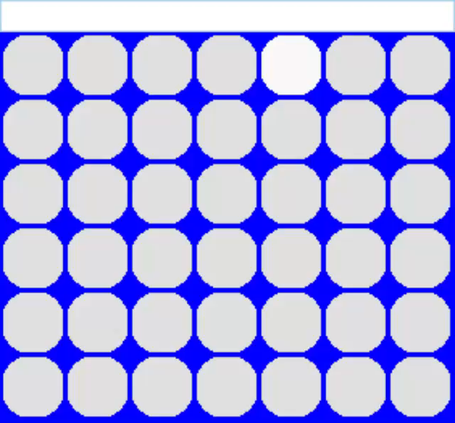
Development Process cont.
What went well
We had a template to work off of
Finding the lowest available row of each column was not an extreme challenge
The player interface made switching between P v. P and P v. Computer easy
What did not go as well
Came across problems with GUI animation as seen on the right
Had some initial challenge with blocking human’s 3-in-a-rows

Slide 4
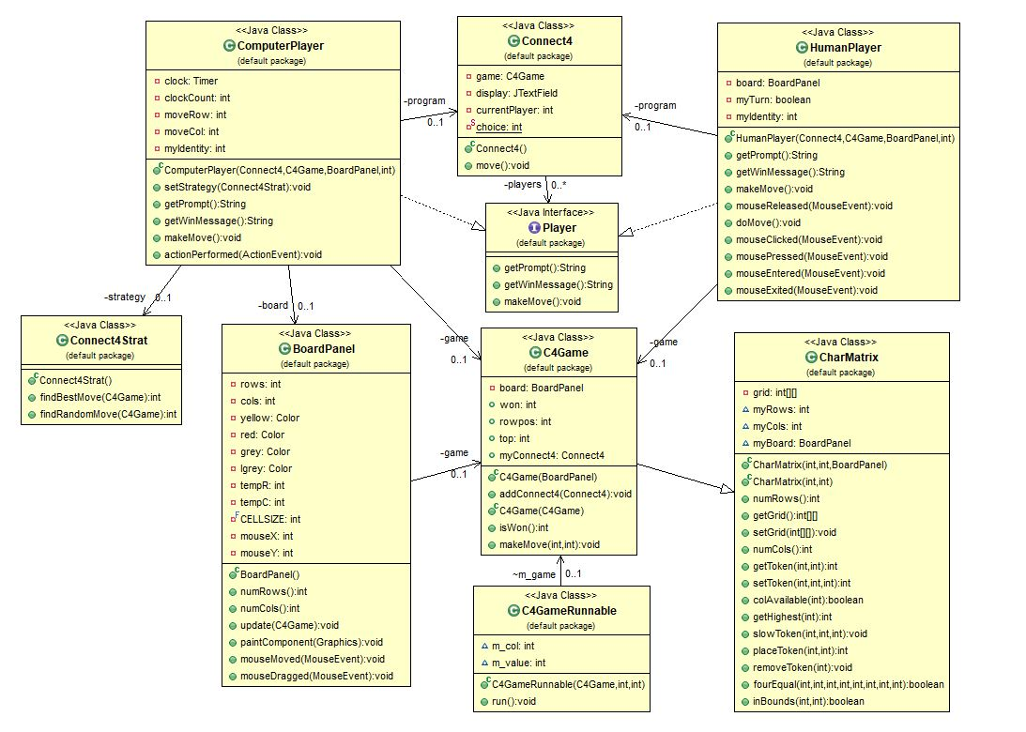
Key Design Elements
This diagram is very similar to the Chomp Diagram – the code however is much different
“Under The Hood Classes” – CharMatrix, C4Game, Connect4Strat classes
A nice thing about the game:
There was no need to worry about a (x,y) location – only column placement matters
A not nice thing about the game:
Animating the falling coin became a little troublesome, so added a C4GameRunnable class to help with this process

Slide 5

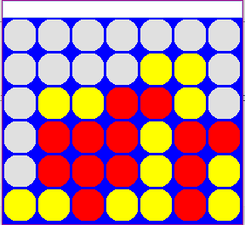
Looking Deeper Into the Design
Checking for a 4-in-a-row across the whole board after each turn is tiring
Use the gameboard to the right as an example
Would need some way to traverse through all possible 4-in-a-rows
We thought of something better
The coin pointed to by the arrow is the most recent move
Then the 5 boxes drawn around are some examples of how this turn can result in a 4-in-a-row
The main point: rather than checking the whole grid each time, check the most recent turn’s surroundings for a win
On more thing
The standard thought process would be to make the win method a boolean
We gave an empty spot a value of 0, a red spot is 1, and yellow is 2
The win method will return -1 for no winner, 1 for red winner and 2 for yellow winner
This was helpful for us

Slide 6
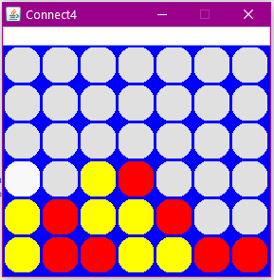
How Does the Computer Player Play?
The computer takes the current game and makes 2 clones
Lets call these smaller circles “pretend coins” or guesses
This is where our setToken method comes in handy
Since it drops a coin in intended column and then checks all around that column for a win, the computer will know if anyone has won
setToken will return 1 if red wins, and 2 if yellow wins
Based off this info:
Clone 1 (the top): the computer will play its own yellow coins first
If it gets a win in this “simulation” when choosing a column the comp will choose this for the main game
As we can see here, the 1st clone does not result in any win so we move on to . . .
Clone 2 (the bottom): the computer thinks “if I don’t win, I’ll try to block the opponent.”
Same as clone 1, however now it will play red dots
If a win for red (method returns 1) is detected, the computer will choose that column for the main game
In this example, computer has spotted a win for red indicated by white rectangle

Slide 7
An Unintended Bonus and GUI Development
It seems intuitive to associate red with human and yellow with a computer
In same way, associate 1 with human and 2 with comp
This leads to problems with deciding 1 player or 2 player
Cannot create 2 HumanPlayer objects is they both point to red
Due to the design, we built a color-number association 🡪 now whichever Human or Computer object had a 1 or a 2, a red or yellow respectively showed up on the screen
These constructor signatures have an identity field – 1 or 2 to point to the corresponding color in the GUI

Slide 8
Gui Design
Game stored in 6x7 2D array
PaintComponent method (indirectly called by repaint) creates a square for each element of the array and fills it in with its color
EventQueue used to allow the screen to update while block falls

Slide 9
Before use of EventQueue
PaintComponent cannot be called while an event is being processed
MouseClicked Event
Java Perspective:
Mouse Event
Loop (x6):
Move token down 1
Refresh screen (fails because MouseEvent has not finished)
Screen refreshes because MouseEvent has finished

Slide 10
After use of EventQueue
MouseEvent is split up and the screen refreshes between each event
MouseClicked Event
Java Perspective:
Mouse Event
E1
E2
E3
...
Loop (x6):
MakeMove
Create Event
*
*
*
*
*
* = graphics updated

